Slide 1

Battle-Puno: 說明文件 Manual of Battle-Puno

Slide 2


Slide 3
簡介|Introduction
想打牌卻沒朋友想跟你一起玩嗎? 別擔心! 本遊戲就是你消磨、打發時間的U質選擇!
相較一般的UNO，更擴充了4種卡牌與兩種模式、配上主題牌組與精心設計的內容來讓所有人邊緣人們享受!
Wanna play the card game but no body wants to play with you! Don’t worry! This game will be one of your good choice to enjoy!
Compared tradition UNO, this game extends 4 more special cards and 2 more modes, and of course, themed cardset and detailed crafted content to enjoy!

Slide 4




使用技術 | Library

Slide 5
遊玩方式
1.標題畫面-開始遊戲
2.選擇模式與客製化興趣選項
3.打!!!!
4.爽爽贏或輸到脫褲

Slide 6
操作方式

Slide 7
架構 | Architecture
(PIXI) Application
Static Class/Module
Manager
Kernel
Instance Class
CoreClass

Slide 8
Architecture::Manager
Manager
SceneManager
EventManager
DataManager
GameManager

Slide 9
Architecture::Kernel
Kernel
Static Class/ Module
Instance Class

Slide 10
Architecture::Kernel::Module
Name | Usage
Input | Detect keymap trigger/press/repeat
Graphics | Graphic/Image resources processing
Sound | Audio/Audio resources processing
Sprite | Extension class of PIXI.Sprite
SpriteCanvas | Collection/Parent of sprites
Rect | Extension class of PIXI.Rect

Slide 11
Architecture::Kernel::InstanceClass
Bitmap:
HTMLCanvasElement
Better utility
Challenge: DisplayOrigin

Slide 12
Architecture::CoreClass
CoreClass
Scene
Window
GameObject

Slide 13
Architecture::CoreClass(cont.)
Just too many too list here, see the source code

Slide 14
Game Play

Slide 15


分工::開發團隊 | Credits::Dev Team
Compeador(Jun-Kai Chao): >> System Kernel developing
>> User Interface >> Resources Collector
WT Cheng: Resources Handler(processing) <<
Game Rules Implement << Puno github.io webpage deployment <<

Slide 16
Credits::Resources

Slide 17




























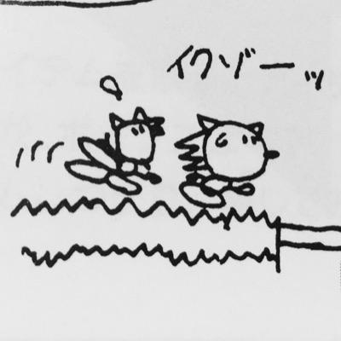




Credits::MyLittlePuno
PUNO制作委員会: Publisher of my little puno, collaborated with 32 talented artists. Link to artist’s page is given in the
hyperlink of profile icon below.

